Slide 1
FIRST COAST GAMES 2024 Healthy Living Challenge
STRENGTHENING THE FOUNDATIONS OF COMMUNITY
YMCA OF FLORIDA’S FIRST COAST | FCYMCA.org

Slide 2
overview
2024 Healthy Living Challenge (HLC) will have a designated Team Captain
HLC Roster will be limited to 10 participants/company
(and up to 5 alternates) *15 total
*Rosters due to Tim Burrows @ tburrows@fcymca.org by Monday, March 18th
HLC will be 6-weeks in duration: Monday, April 1 – Sunday, May 12
*pre-screenings held: Monday, March 25 – Sunday, March 31
*post-screenings held: Monday, May 13 – Sunday, May 19
**Pre/Post-screening will be completed at the following branches:
Brooks Family YMCA / Williams Family YMCA / Winston Family YMCA
HLC participants are able to also participate in Challenge and Recreational events
HLC participant requirements:
1. Complete Pre-screening
2. Complete Post-screening

Slide 3
RESET activity cards
Along with the FREE month of membership …
HLC participants will receive 14 complimentary Guest Visits to complete the Y related activities on the RESET Activity card
Card will have 24 different activities that can be completed inside and outside the walls of the Y
12 of the 24 activities must be completed (50%)
Card must be turned in at Post-Screening to earn points
**RESET Cards are completed on the honor system
**One month membership redeemed during month of April
**14 Healthy Living Challenge punch card visits used between
May 1 – May 12

Slide 4
2024 First Coast Games – Healthy Living Challenge ways to engage…

Slide 5
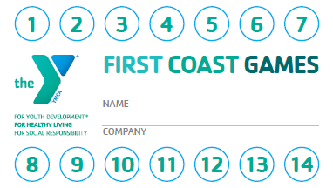
RESET activity card & FCG HLC guest pass - SAMPLEs

Slide 6
Y360 – Virtual platform
All rostered HLC participants will receive complimentary subscription during the Healthy Living Challenge

Slide 7
First coast Ymca – running groups Locations: days / times Baptist North: Mon/Wed @ 5:30pm Brooks: wed @ 6:30pm / sat @ 7Am Brown: Wed @ 5:15PM / Sat @ 8:15am Winston: tues/Thurs @ 6pm

Slide 8
Team scoring
Completed Pre-Screening: 2 pt./participant (max 20 pts.)
Completed Post-Screening: 4 pt./participant (max 40 pts.)
Total Possible Points: 60

Slide 9
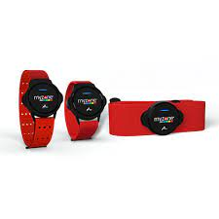
Overall Individual
Categories:
% Body Weight
% Body Fat
*Prizes for each category:
Overall winner in each category will receive:
*2 month Adult or Family FFC Membership
*Myzone Switch

Slide 10
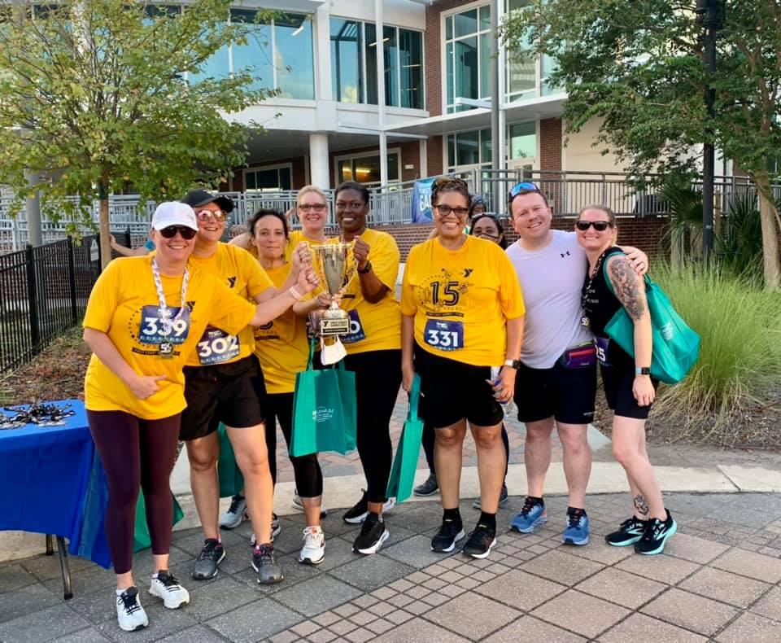
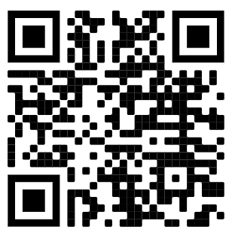
First Coast Games Facebook Page

Slide 11
First Coast Games FaceBook Page
YMCA's FIRST COAST GAMES Facebook page: https://www.facebook.com/groups/YMCAFirstCoastGames
Great way to connect companies to share achievements, photos and stories
We also invite you to reach out to other teams to set up practice and/or scrimmage times
Please remember this is an open group, so we ask you to help us honor our YMCA values and keep the "smack talk" friendly!
Feel free to invite other FCG friends
When posting, please use:
#FirstCoastGames, tag @FirstCoastYMCA

Slide 12
On behalf of the First Coast Games Team, we hope you look forward to the Healthy Living Challenge! Questions? Contact Dana Troeger at dtroeger@fcymca.org or Tim Burrows at tburrows@fcymca.org

